Slide 1
IP ADDRESSING
Master Nguyen Huu Trung
Faculty Of Information Technology
HCMC University of Technology and Education

Slide 2
What Internet Protocol ?
The Internet Protocol (IP) is the principal communications protocol used for network packets across an internetwork using the Internet Protocol Suite. Responsible for routing packets across network boundaries, it is the primary protocol that establishes the Internet.
IPv4 – 32 bits – 9/1981 by IETF (RFC – 791)
IPv6 – 128 bits
Notes:
Giao thức Internet (IP) là giao thức truyền thông chính sử dụng cho các gói chuyển tiếp (còn được gọi là các gói tin mạng) qua một liên mạng bằng cách sử dụng giao thức Internet Suite.Chịu trách nhiệm về định tuyến các gói tin qua các biên giới mạng, nó là giao thức chính thiết lập Internet.

Slide 3
Internet Protocol Characteristics
Operates at network layer of OSI
Connectionless protocol
Packets treated independently
Hierarchical addressing
No data-recovery feature
Best-effort delivery
Notes:
1. Internet Protocol Characteristics
Hoạt động ở tầng mạng (L3) của mô hình OSI
Giao thức kết nối ngay lập tức
Xử lý gói dữ liệu một cách độc lập
Phân cấp địa chỉ
Không có tính năng phục hồi dữ liệu
Nỗ lực phân phối tốt nhất
Internet Protocol suite
Internet protocol suite
Application layer
DHCP
DHCPv6
DNS
FTP
HTTP
IMAP
IRC
LDAP
MGCP
NNTP
BGP
OSPF
NTP
POP
RPC
RTP
RTSP
RIP
SIP
SMTP
SNMP
SOCKS
SSH
Telnet
TLS/SSL
XMPP
(more)
Transport layer
TCP
UDP
DCCP
SCTP
RSVP
(more)
Internet layer
IP
IPv4
IPv6
ICMP
ICMPv6
ECN
IGMP
IPsec
(more)
Link layer ARP/InARP
NDP
Tunnels
L2TP
PPP
Media access control
Ethernet
DSL
ISDN
FDDI
(more)

Slide 4
What IP Addresses?
An IP address under Internet Protocol Version 4 is a number that is assigned to a device that allows other devices on the network to locate and reach it.
Notes:
Một địa chỉ IP theo Internet Protocol Version 4 là một con số được gán cho một thiết bị cho phép các thiết bị khác trên mạng để xác định vị trí và đạt được nó.

Slide 5
Examples of devices that need IP addresses?
PC
Servers
Printers
Disk arrays
Routers
Firewalls
Switches
Wireless access points
PDA
Mobile phones
IP phones
Online gaming systems
TV …

Slide 6
Why IP Addresses?
They uniquely identify each device on an IP network
Every host (computer, networking device) must have a unique address
Host ID:
identifies the individual host
is assigned by organization to individual devices
Network.Host
Notes:
Họ xác định duy nhất mỗi thiết bị trên một mạng ip Mỗi máy chủ (máy tính, thiết bị mạng, thiết bị ngoại vi) phải có một địa chỉ duy nhất Lưu trữ ID: xác định các máy chủ cá nhân được phân công của tổ chức cho các thiết bị cá nhân

Slide 7
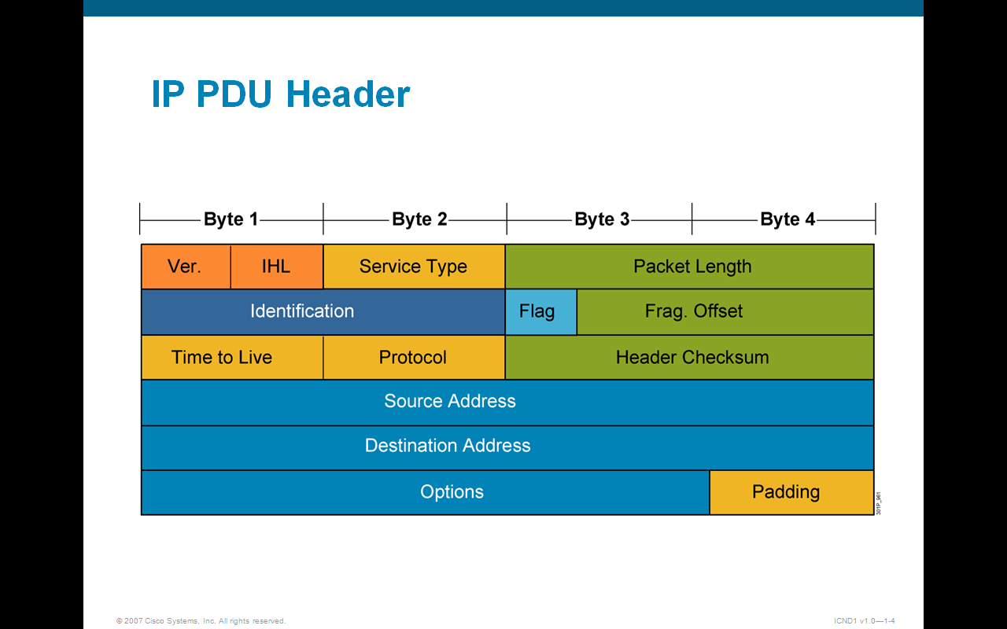
IP PDU Header
Notes:
Packet structure
An IP packet consists of a header section and a data section.
Header
The IPv4 packet header consists of 14 fields, of which 13 are required. The 14th field is optional and aptly named: options.
Data
1. Version (Ver): The first header field in an IP is the four-bit version field. For IPv4, this has a value of 4 (hence the name IPv4).
2. Internet Header Length (IHL): The second field (4 bits) is the Internet Header Length (IHL), which is the number of 32-bit words in the header. Since an IPv4 header may contain a variable number of options, this field specifies the size of the header (this also coincides with the offset to the data). The minimum value for this field is 5 (RFC 791), which is a length of 5×32 = 160 bits = 20 bytes. Being a 4-bit value, the maximum length is 15 words (15×32 bits) or 480 bits = 60 bytes.
3. Differentiated Services Code Point (DSCP) Originally defined as the Type of Service field, this field is now defined by RFC 2474 for Differentiated services (DiffServ). New technologies are emerging that require real-time data streaming and therefore make use of the DSCP field. An example is Voice over IP (VoIP), which is used for interactive data voice exchange. Explicit Congestion Notification (ECN) This field is defined in RFC 3168 and allows end-to-end notification of network congestion without dropping packets. ECN is an optional feature that is only used when both endpoints support it and are willing to use it. It is only effective when supported by the underlying network.
4. Total Length This 16-bit field defines the entire packet (fragment) size, including header and data, in bytes. The minimum-length packet is 20 bytes (20-byte header + 0 bytes data) and the maximum is 65,535 bytes — the maximum value of a 16-bit word. The largest datagram that any host is required to be able to reassemble is 576 bytes, but most modern hosts handle much larger packets. Sometimes subnetworks impose further restrictions on the packet size, in which case datagrams must be fragmented. Fragmentation is handled in either the host or router in IPv4.
5. Identification This field is an identification field and is primarily used for uniquely identifying fragments of an original IP datagram. Some experimental work has suggested using the ID field for other purposes, such as for adding packet-tracing information to help trace datagrams with spoofed source addresses.
6. Flags A three-bit field follows and is used to control or identify fragments. They are (in order, from high order to low order): bit 0: Reserved; must be zero.
bit 1: Don't Fragment (DF)
bit 2: More Fragments (MF)
If the DF flag is set, and fragmentation is required to route the packet, then the packet is dropped. This can be used when sending packets to a host that does not have sufficient resources to handle fragmentation. It can also be used for Path MTU Discovery, either automatically by the host IP software, or manually using diagnostic tools such as ping or traceroute. For unfragmented packets, the MF flag is cleared. For fragmented packets, all fragments except the last have the MF flag set. The last fragment has a non-zero Fragment Offset field, differentiating it from an unfragmented packet.
7. Fragment Offset The fragment offset field, measured in units of eight-byte blocks, is 13 bits long and specifies the offset of a particular fragment relative to the beginning of the original unfragmented IP datagram. The first fragment has an offset of zero. This allows a maximum offset of (2¹³ – 1) × 8 = 65,528 bytes, which would exceed the maximum IP packet length of 65,535 bytes with the header length included (65,528 + 20 = 65,548 bytes).
8. Time To Live (TTL) An eight-bit time to live field helps prevent datagrams from persisting (e.g. going in circles) on an internet. This field limits a datagram's lifetime. It is specified in seconds, but time intervals less than 1 second are rounded up to 1. In practice, the field has become a hop count—when the datagram arrives at a router, the router decrements the TTL field by one. When the TTL field hits zero, the router discards the packet and typically sends a ICMP Time Exceeded message to the sender. The program traceroute uses these ICMP Time Exceeded messages to print the routers used by packets to go from the source to the destination.
9. Protocol This field defines the protocol used in the data portion of the IP datagram. The Internet Assigned Numbers Authority maintains a list of IP protocol numbers which was originally defined in RFC 790.
10. Header Checksum Main article: IPv4 header checksum
The 16-bit checksum field is used for error-checking of the header. When a packet arrives at a router, the router calculates the checksum of the header and compares it to the checksum field. If the values do not match, the router discards the packet. Errors in the data field must be handled by the encapsulated protocol. Both UDP and TCP have checksum fields. When a packet arrives at a router, the router decreases the TTL field. Consequently, the router must calculate a new checksum. RFC 1071 defines the checksum calculation: The checksum field is the 16-bit one's complement of the one's complement sum of all 16-bit words in the header. For purposes of computing the checksum, the value of the checksum field is zero. For example, consider Hex 4500003044224000800600008c7c19acae241e2b (20 bytes IP header): Step 1) 4500 + 0030 + 4422 + 4000 + 8006 + 0000 + 8c7c + 19ac + ae24 + 1e2b = 2BBCF (16-bit sum) Step 2) 2 + BBCF = BBD1 = 1011101111010001 (1's complement 16-bit sum) Step 3) ~BBD1 = 0100010000101110 = 442E (1's complement of 1's complement 16-bit sum) To validate a header's checksum the same algorithm may be used - the checksum of a header which contains a correct checksum field is a word containing all zeros (value 0): 2BBCF + 442E = 2FFFD. 2 + FFFD = FFFF. the 1'S of FFFF = 0.
11. Source address This field is the IPv4 address of the sender of the packet. Note that this address may be changed in transit by a network address translation device.
12. Destination address This field is the IPv4 address of the receiver of the packet. As with the source address, this may be changed in transit by a network address translation device.
13. Options The options field is not often used. Note that the value in the IHL field must include enough extra 32-bit words to hold all the options (plus any padding needed to ensure that the header contains an integral number of 32-bit words). The list of options may be terminated with an EOL (End of Options List, 0x00) option; this is only necessary if the end of the options would not otherwise coincide with the end of the header. The possible options that can be put in the header are as follows: Field Size (bits) Description Copied 1 Set to 1 if the options need to be copied into all fragments of a fragmented packet. Option Class 2 A general options category. 0 is for "control" options, and 2 is for "debugging and measurement". 1, and 3 are reserved. Option Number 5 Specifies an option. Option Length 8 Indicates the size of the entire option (including this field). This field may not exist for simple options. Option Data Variable Option-specific data. This field may not exist for simple options. Note: If the header length is greater than 5, i.e. it is from 6 to 15, it means that the options field is present and must be considered.
Note: Copied, Option Class, and Option Number are sometimes referred to as a single eight-bit field - the Option Type.
The following two options are discouraged because they create security concerns: Loose Source and Record Route (LSRR) and Strict Source and Record Route (SSRR). Many routers block packets containing these options.^{[11]}

Slide 8
IP Address Format: Dotted Decimal Notation
IP v4: 32 bit (range value 0 to 4,294,967,295) | Example
 | 1101010101010100001100101001011
For Readability, the 32 bit binary number can be devided into four 8bit octets | 11010101 | 0101010 | 00011001 | 01001011
Each Octet (or byte) can be converted to decimal | 106 | 170 | 25 | 75
The address can be written in dotted decimal notation | 106. | 170. | 25. | 75

Slide 9
IP Address Classes: The First Octet
A B C…Easy as 1 2 3
Class A – First 1 bit fixed
0XXXXXXX
.
Host
.
Host
.
Host
Class B – First 2 bit fixed
10XXXXXX
.
Network
.
Host
.
Host
Class C – First 3 bit fixed
110XXXXX
.
Network
.
Network
.
Host

Slide 10
IP Address Classes: The First Octet
A B C…Easy as 1 2 3
Class D – First 4 bit fixed
1110XXXX
.
Host
.
Host
.
Host
Class E – First 5 bit fixed
11110XXX
.
Network
.
Host
.
Host

Slide 11
IP Address Ranges
IP Address Class | First Octet Binary Value | First Octet Decimal Value | Possible Number of Hosts
Class A | 00000001 to 011111110 | 1 to 126 | 16,777,214 2²⁴ - 2
Class B | 10000000 to 10111111 | 128 to 191 | 65,534 2¹⁶ – 2
Class C | 11000000 to 11011111 | 192 to 223 | 254 2⁸ – 2
1. The 127.0.0.0 network is the loopback network and not used on the internet. 2. Address loopback address 127.0.0.1 is used to check TCP / IP 3. IP's that have the last octet as 255 are not assigned to hosts; 0.0.0.0 and 255.255.255.255 are not assigned to anything.

Slide 12
Reserved Address
Network Addresses
Broadcast Addresses
32 bits
Network
0000000000000000
32 bits
Network
1111111111111111

Slide 13
Private IP Addresses (RFC-1918)
Class
Private IP Ranges
A
10.0.0.0 to 10.255.255.255
B
172.16.0.0 to 172.31.255.255
C
192.168.0.0 to 192.168.255.255

Slide 14
Public IP Addresses
Class
Public IP Ranges
A
1.0.0.0 to 9.255.255.255
11.0.0.0 to 126.255.255.255
B
128.0.0.0 to 172.15.255.255
172.32.0.0 to 191.255.255.255
C
192.0.0.0 to 192.167.255.255
192.169.0.0 to 223.255.255.255

Slide 15
Convert Decimal to Binary
Method 1:
Ví dụ: 108₍₁₀₎ → Binary
Balance
108
/2
0
Result
54
/2
0
27
/2
1
13
/2
1
6
/2
0
108 ₍₁₀₎ =
1101100 ₍₂₎
3
/2
1
1
/2
1
0
/2
0

Slide 16
Convert Decimal to Binary
Method 2: <= 255
2⁷ | 2⁶ | 2⁵ | 2⁴ | 2³ | 2² | 2¹ | 2⁰ → 128 | 64 | 32 | 16 | 8 | 4 | 2 | 1
Example 1: Convert 108 → Binary
Bits
Remainder
108
-128
0
108
Result
108
-64
1
44
44
-32
1
12
12
-16
0
12
12
-8
1
4
1101100 ₍₂₎
108 =
4
-4
1
0
0
-2
0
0
0
-1
0
0

Slide 17
Convert Decimal to Binary
Method 2: <= 255
2⁷ | 2⁶ | 2⁵ | 2⁴ | 2³ | 2² | 2¹ | 2⁰ → 128 | 64 | 32 | 16 | 8 | 4 | 2 | 1
Exercise 1: Convert 235 → Binary
Bits
Remainder
235
-128
1
107
Result
107
-64
1
43
43
-32
1
11
11
-16
0
11
11
-8
1
3
11101011 ₍₂₎
235 =
3
-4
0
3
3
-2
1
1
1
-1
1
0

Slide 18
Convert Decimal to Binary
Method 2: <= 255
2⁷ | 2⁶ | 2⁵ | 2⁴ | 2³ | 2² | 2¹ | 2⁰ → 128 | 64 | 32 | 16 | 8 | 4 | 2 | 1
Exercise 2: Convert 109 → Binary
Bits
Remainder
109
-128
0
109
Result
109
-64
1
45
45
-32
1
13
13
-16
0
13
13
-8
1
5
01101101 ₍₂₎
109 =
5
-4
1
1
1
-2
0
1
1
-1
1
0

Slide 19
Convert Decimal to Binary
Method 2: >=255
2⁸ | 2⁷ | 2⁶ | 2⁵ | 2⁴ | 2³ | 2² | 2¹ | 2⁰ → 256 | 128 | 64 | 32 | 16 | 8 | 4 | 2 | 1
Example 2: Convert 457 → Binary
Bits
Remainder
457
-256
1
201
Kết quả
201
-128
1
73
73
-64
1
9
9
-32
0
9
9
-16
0
9
111001001 ₍₂₎
457 =
9
-8
1
1
1
-4
0
1
1
-2
0
1
1
-1
1
0

Slide 20
Convert Binary to Decimal
Method 1: Guest weights to binary numbers, increasing from right to left; first weight is 0.
Example:
1 1 0 1 1 0 0 ₍₂₎ = 2⁶+2⁵+2³+2² = 108₍₁₀₎
The weights
6 5 4 3 2 1 0

Slide 21
Convert Binary to Decimal
Method 2:
Example:
01 1 0 1 1 0 0 ₍₂₎ = 64+32+8+4 = 108₍₁₀₎
Value
128
64
32
16
8
4
2
1
Bit
0
1
1
0
1
1
0
0

Slide 22
Convert Binary to Decimal
Method 3: If bit 0, then we use (2 * previous value), if bit 1, we use (2 * previous value + 1)
Example:
01 1 0 1 1 0 0 ₍₂₎ = 2*54 = 108₍₁₀₎
Value
2*0
2*0+1
2*1 +1
2*3
2*6+1
2*13+1
2*27
2*54
Bit
0
0
1
1
1
1
0
0
1
1
1
1
0
0
0
0

Slide 23
Exercies
Convert Decimal to Binary
192
203
168
240
250
Convert Binary to Decimal
10111011
10111101
11000110
11000000
11001011
10101000
11110000
11111010
187
189
198

Slide 24
Exercises: Convert these decimal numbers to binary:
1. 0
2. 6
3. 14
4. 25
5. 49
6. 63
7. 98
8. 107
9. 122
10. 136
11. 163
12. 200
13. 219
14. 243
15. 253
16. 256
17. 285
18. 302
19. 483

Slide 25
Exercises: Convert these binary numbers to decimal:
20. 00110011
21. 00000000
22. 11111111
23. 11100011
24. 00001111
25. 11111100
26. 01010111
27. 00000110
28. 11110000
29. 01100111
30. 11001111
31. 00111101
32. 11100001
33. 10011110
34. 100000000

Slide 26
Boolean Logical AND/OR operation
A | B | A and B | A or B
1 1 0 0 | 1 0 1 0 | 1 0 0 0 | 1 1 1 0

Slide 27
What Subnet Mask?
A subnet mask is a special IPv4 number, like 255.255.255.0, that along with the IP address, gives us the exact network address.
All bits of the Network: 1
All bits of the Host : 0
Notes:
Một subnet mask là một IPv4 số đặc biệt, như 255.255.255.0, cùng với địa chỉ IP, cung cấp cho chúng ta địa chỉ mạng chính xác.

Slide 28


Why do we need subnet masks?
Example
Address:95 Thong Nhat,Binh Tho, Thu Duc,HCM
Address:95 Thong Nhat
OK
X
?
Address:95 Thong Nhat,Vinh Hai, TP. Nha Trang,Khanh Hoa
?
X
?
X
Address:95 Thong Nhat,Binh Tho, TP. My Tho,Tien Giang
Add Location:Binh Tho,Thu Duc,HCM
Subnet Mask
Without a city name and postal code on the envelope,
it’s pretty hard for the postman to deliver a package
Notes:
An address is useful when it not only identifies a device, but also includes location or area information
Without a subnet mask, it's difficult or impossible to precisely
locate a device on the internet just based on an IP address

Slide 29
Default Subnet Mask
IP address Class | Binary Value | Decimal Value | "/" notation
Class A | 11111111.00000000.00000000.00000000 | 255.0.0.0 | /8
Class B | 11111111.11111111.00000000.00000000 | 255.255.0.0 | /16
Class C | 11111111.11111111.11111111.00000000 | 255.255.255.0 | /24

Slide 30
IP Address → Subnet Mask → Network Address
Example 1: Suppose we have an IP address 10011110.00011111.01110110.00011110/16. Network Address?
1
1
0
0
0
0
1
1
1
1
1
1
1
1
0
0
1
0
0
0
0
0
1
1
1
1
1
1
1
1
0
1
AND
1
1
1
1
1
1
1
1
1
1
1
1
1
1
1
1
1
1
1
1
1
1
1
1
1
1
1
1
1
1
1
1
1
0
0
1
1
1
1
0
0
0
0
1
1
1
1
1
128 + 16 + 8 + 4 +2
16 + 8 + 4 +2 +1
158
31

Slide 31
IP Address → Subnet Mask → Network Address
Example 1: Suppose we have an IP address 10011110.00011111.01110110.00011110/16. Network Address?
10011110
00011111
01110110
00011110
AND
11111111
11111111
00000000
00000000
10011110
00011111
00000000
00000000
158
31
0
0

Slide 32
IP Address → Subnet Mask → Network Address
Example 2: Suppose we have an IP address 214.158.88.203/24. Network Address?
11010110
10011101
01011000
11001011
AND
11111111
11111111
11111111
00000000
11010110
10011101
01011000
00000000
214
158
88
0

Slide 33
IP Address → Subnet Mask → Network Address
Example 3: Suppose we have an IP address 17.143.229.15/8. Network Address?
00010001
10001111
11100101
00001111
AND
11111111
00000000
00000000
00000000
00010001
00000000
00000000
00000000
17
0
0
0

Slide 34
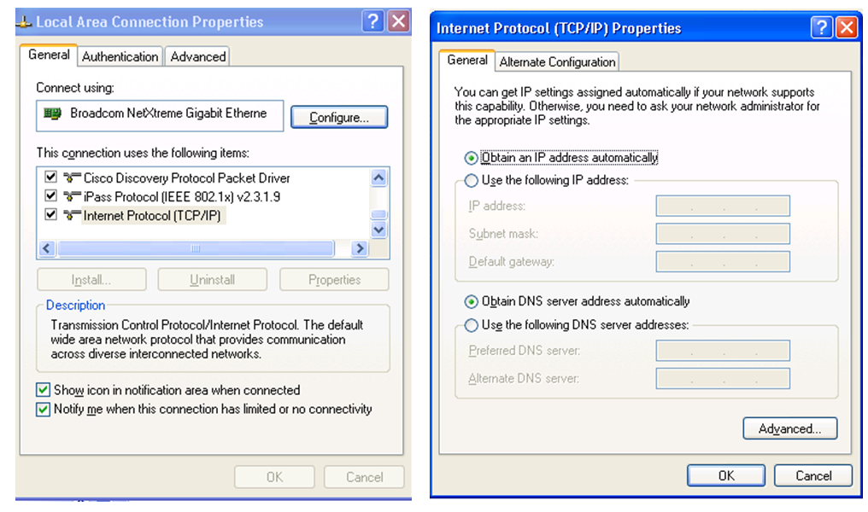
Network Connection

Slide 35
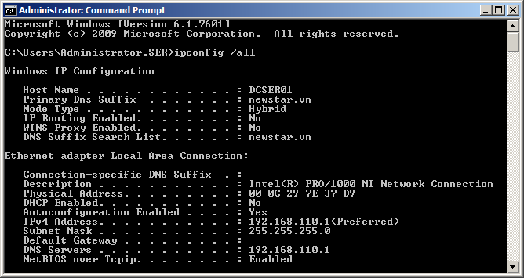
Ipconfig /all [/release] [/renew]

Slide 36
Summary
IP network addresses consist of two parts: the network ID and the Host ID.
IPv4 addresses have 32 bits that are divided into Octets and are generally shown in dotted decimal form. For example: 203.162.177.81)
When written in a binary format, the first bit of a Class A address is always 0, the first 2 bits of a Class B address are always 10 and the first 3 bits of a Class C address are always 110.
Know how to convert from Decimal to Binary and Binary to Decimal
Know how to calculate from the IP network address

Slide 37
Exercises: IP Class Recognize
Recognize these features:
☞ Class of IP address
☞ Public or Private
☞ Default Subnet Mask

Slide 38
Exercises 15 minutes: IP Class Recognize
Apply to the following IP address (Class of IP address,
Public or Private, Default Subnet Mask
a. 171.10.1.1
b. 172.31.1.1
c. 6.12.2.1
d. 10.22.22.10
e. 192.168.1.10
f. 221.222.200.1
g. 129.6.5.4
h. 172.18.16.1
I. 191.168.1.1
j. 166.64.12.12

Slide 39
Exercise
Tìm hiểu các lệnh về network trong MS-Dos và ví dụ minh họa.
Giải thích IP PDU Header

Slide 40
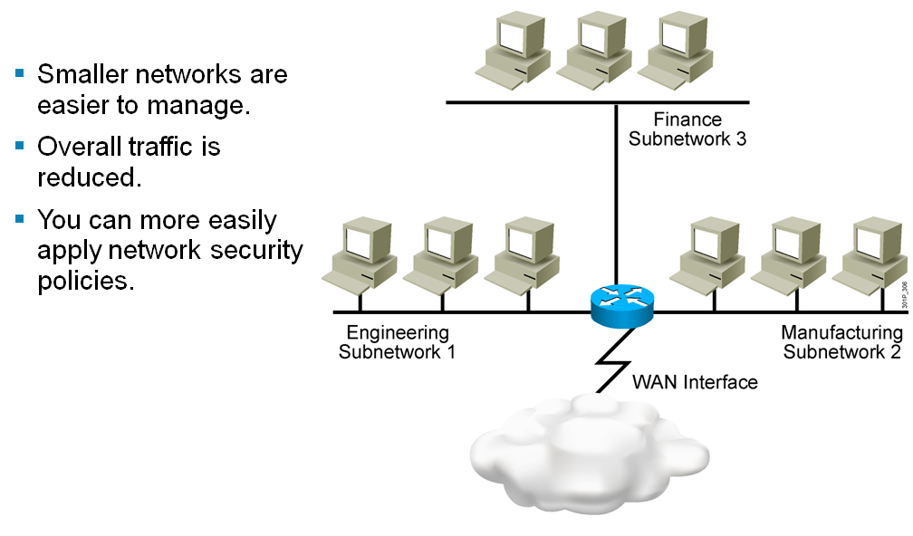
Subnetworks
Notes:
nhỏ hơn mạng dễ dàng hơn để quản lý giao thông tổng thể được giảm bạn có thể dễ dàng áp dụng các chính sách an ninh mạng

Slide 41
Subnetting
Subnetting (chia mạng con) là kỹ thuật sử dụng (mượn) một số bit phần Host_ID tham gia vào phần Network_ID.
Khi đó, để nhận diện ra (subnet) ta dùng đến Subnet Mask.
Subnet mask có độ dài 32 bit, chia làm 4 octet, mỗi phần 8 bit cũng giống như địa chỉ IP Các bit 1: chỉ ra các bit tham gia vào phần NetWork_ID Các bit 0: các bit tham gia vào phần Host_ID
NETWORK
SUBNET
HOST

Slide 42
Subnetting (tt)
Công thức tính ra một Subnet:
IP_Address AND Subnet_Mask =Network_Address
Gọi s là số bit mượn phần Host_ID, h là số bit phần Host_ID còn lại thì:
- Số lượng mạng con (subnet) sinh ra là: 2^^{s}
- Số lượng host/mạng con = 2^^{h}-2
A | B | A and B | A or B
1 1 0 0 | 1 0 1 0 | 1 0 0 0 | 1 1 1 0

Slide 43
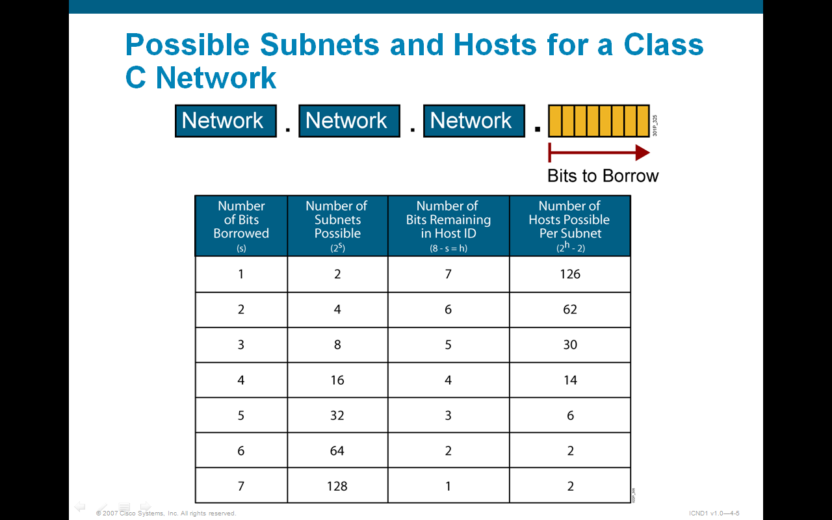
Possible Subnets and Hosts for a Class C Network

Slide 44
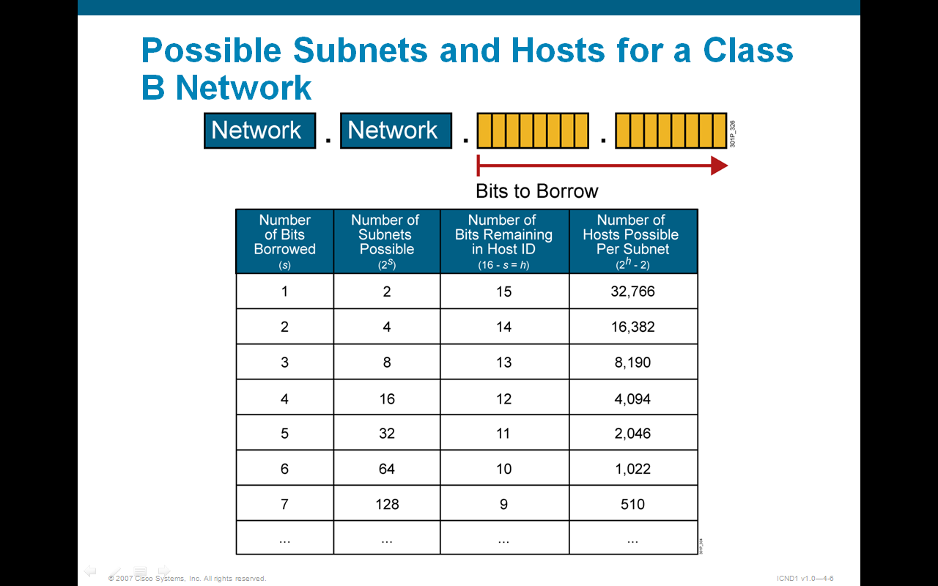
Possible Subnets and Hosts for a Class B Network

Slide 45
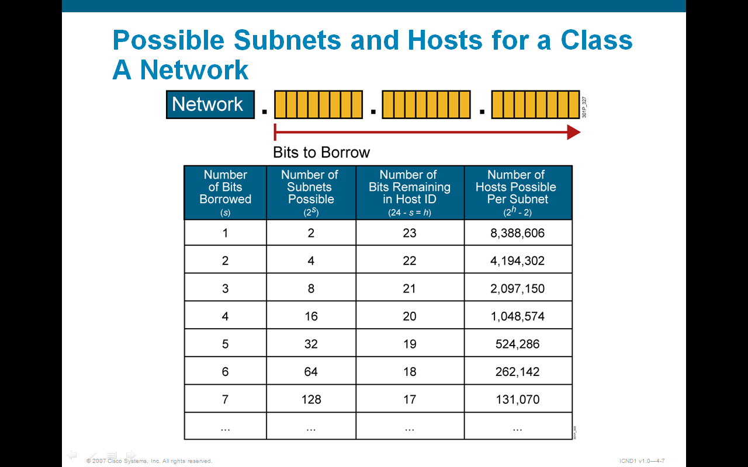
Possible Subnets and Hosts for a Class A Network

Slide 46
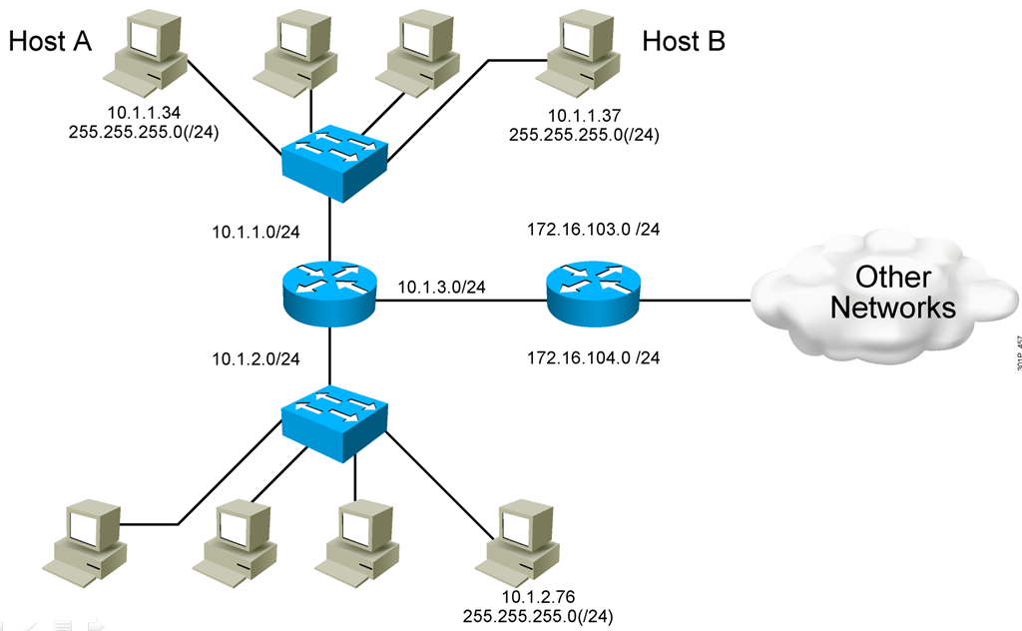
End System Subnet Mask Operation

Slide 47
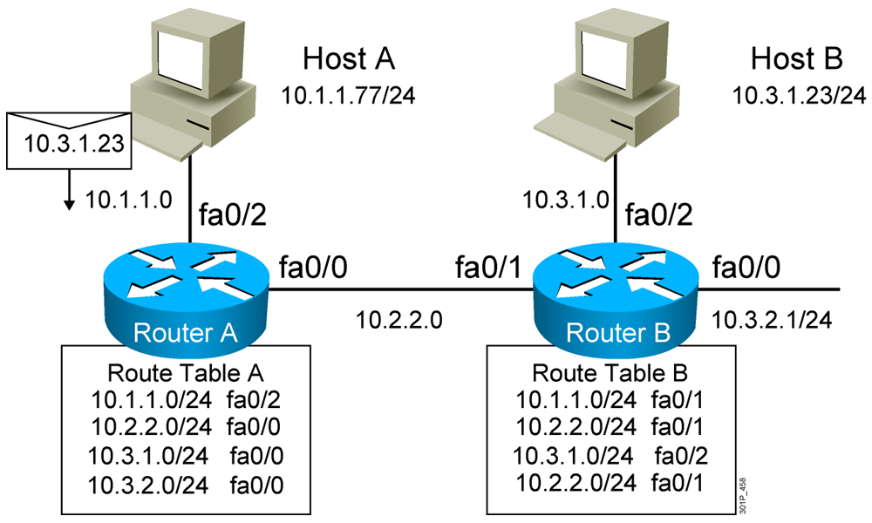
How Routers Use Subnet Masks

Slide 48
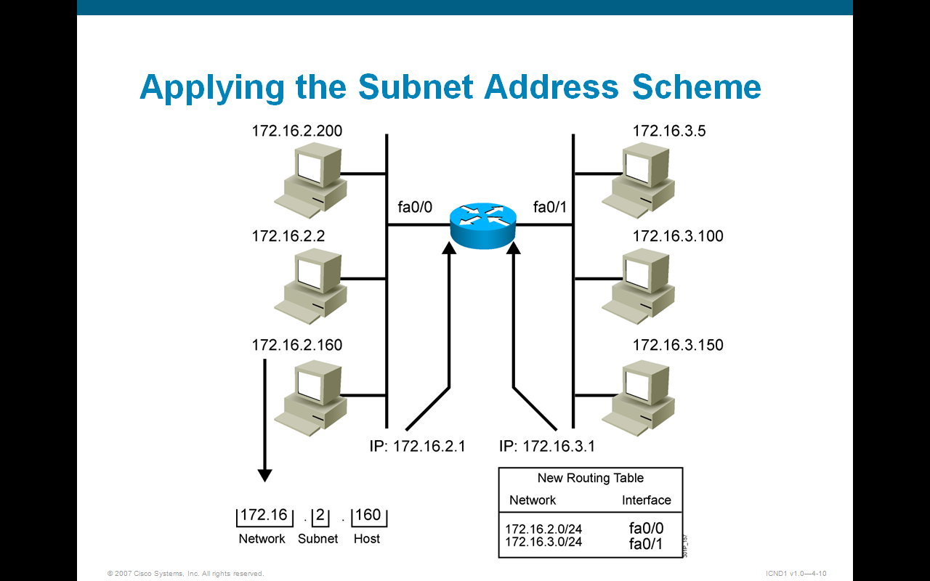
Applying the Subnet Address Scheme

Slide 49
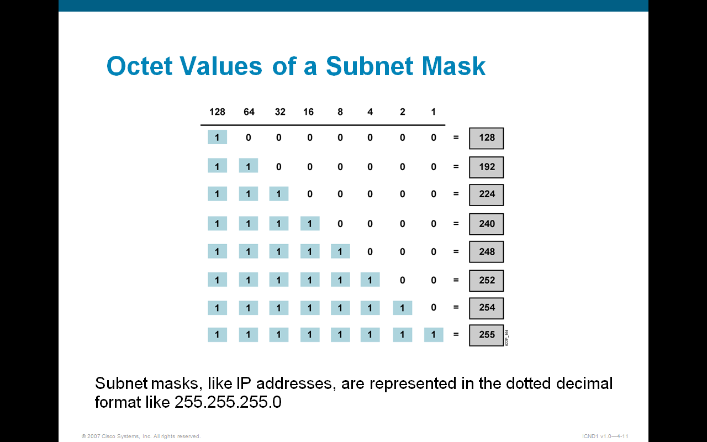
Octet Values of a Subnet Mask

Slide 50
Default Subnet Mask
IP address Class | Binary Value | Decimal Value | "/" notation
Class A | 11111111.00000000.00000000.00000000 | 255.0.0.0 | /8
Class B | 11111111.11111111.00000000.00000000 | 255.255.0.0 | /16
Class C | 11111111.11111111.11111111.00000000 | 255.255.255.0 | /24

Slide 51
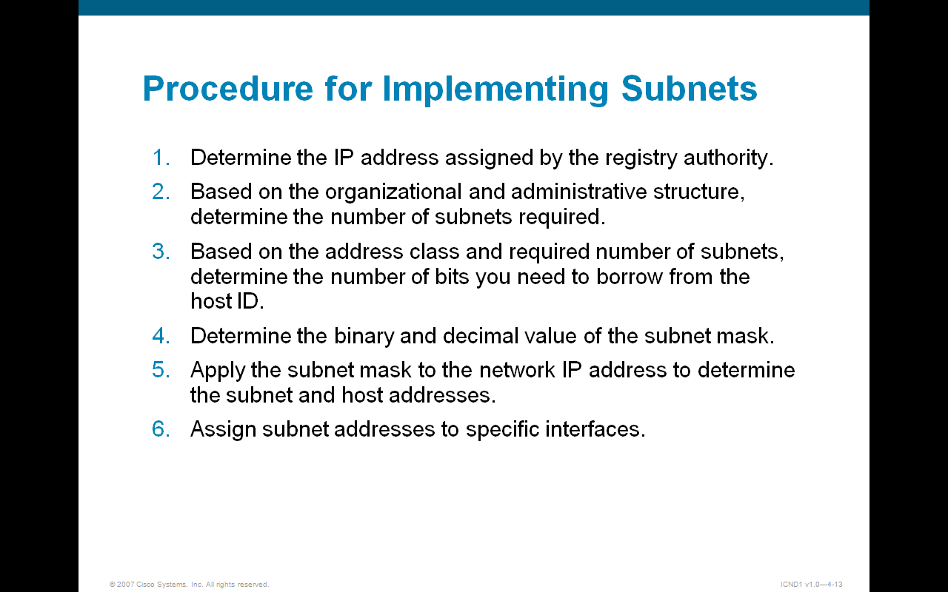
Procedure for Implementing Subnets
Notes:
Thủ tục thực hiện Subnets
xác định địa chỉ ip của cơ quan đăng ký giao dựa trên cơ cấu tổ chức và hành chính, xác định số lượng mạng con yêu cầu

Slide 52
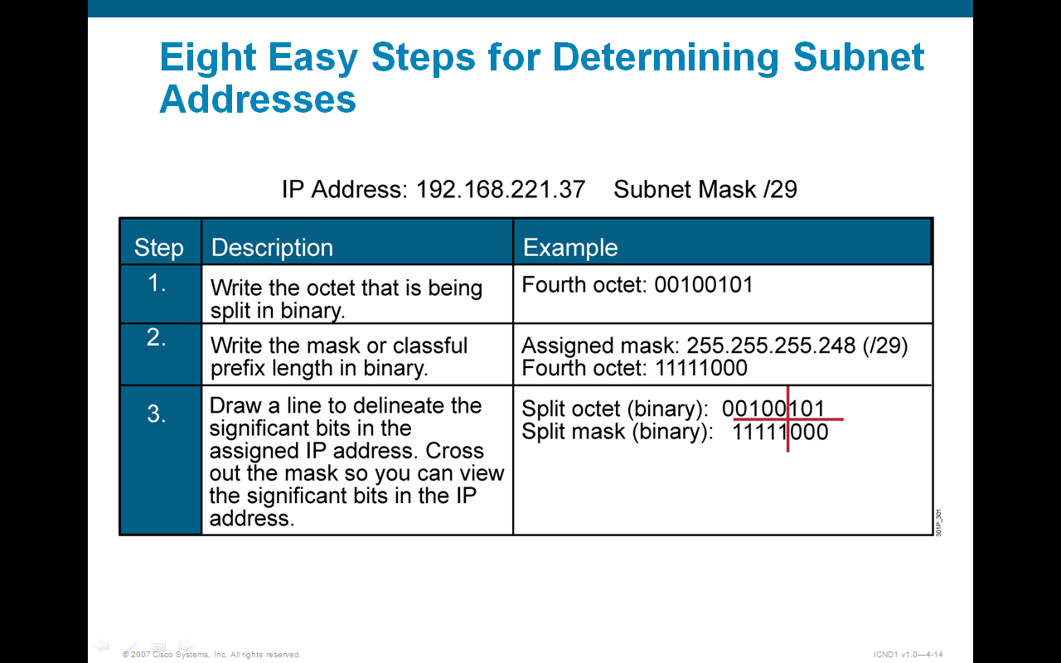
Eight Easy Steps for Determining Subnet Addresses
Notes:
8 bước để chia subnet
Viết địa chỉ dưới dạng nhị phân
Viêt subnet mask dưới dạng nhị phân
Kẻ đường phân cách octet và mask có IP cho mượn

Slide 53
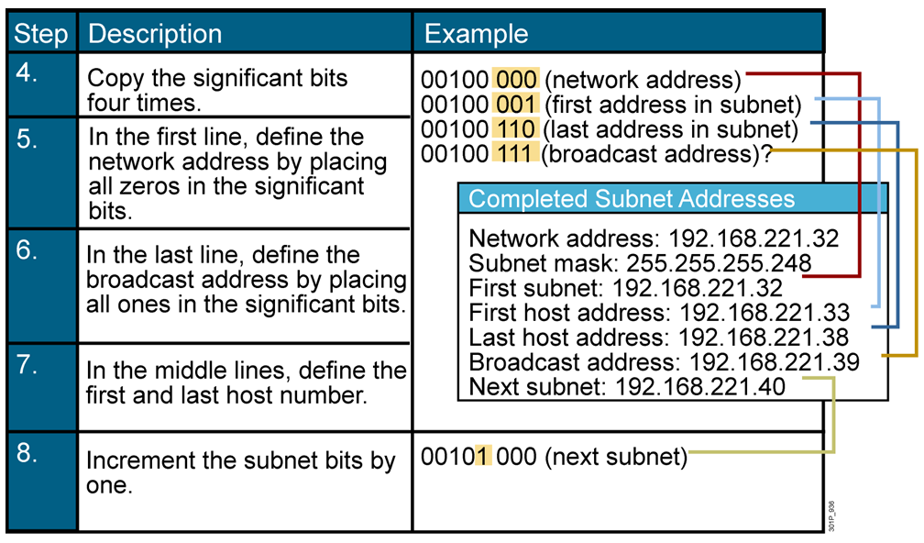
Eight Easy Steps for Determining Subnet Addresses (Cont.)
Notes:
4.

Slide 54
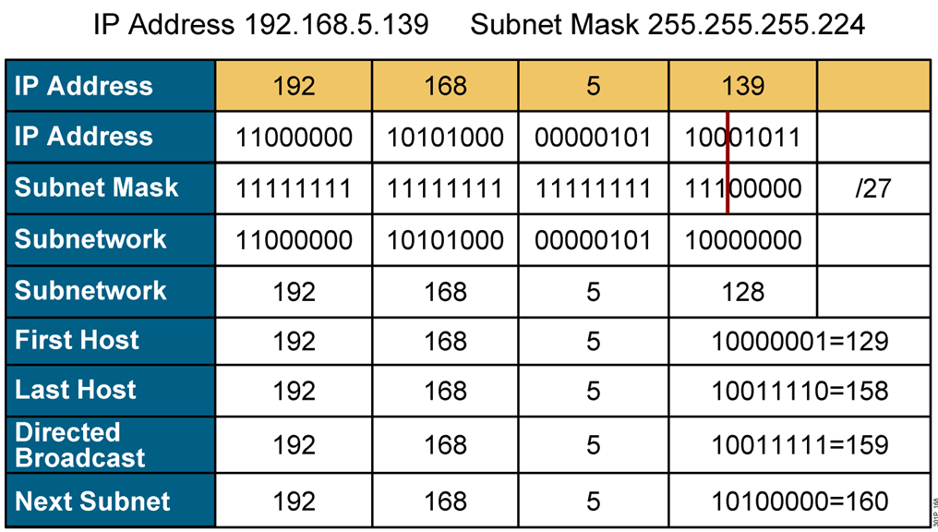
Example: Applying a Subnet Mask for a Class C Address

Slide 55
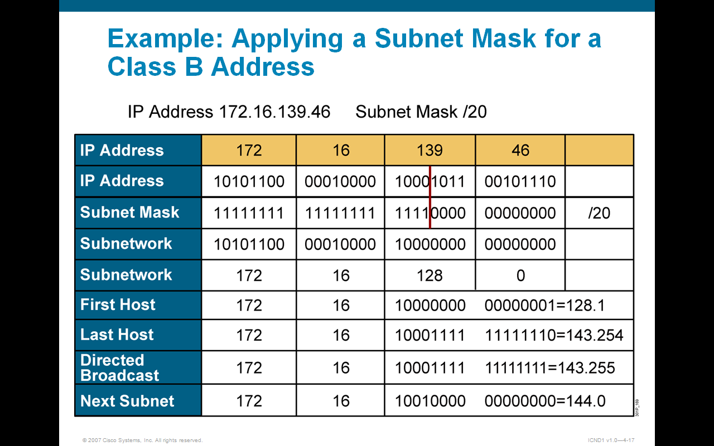
Example: Applying a Subnet Mask for a Class B Address

Slide 56
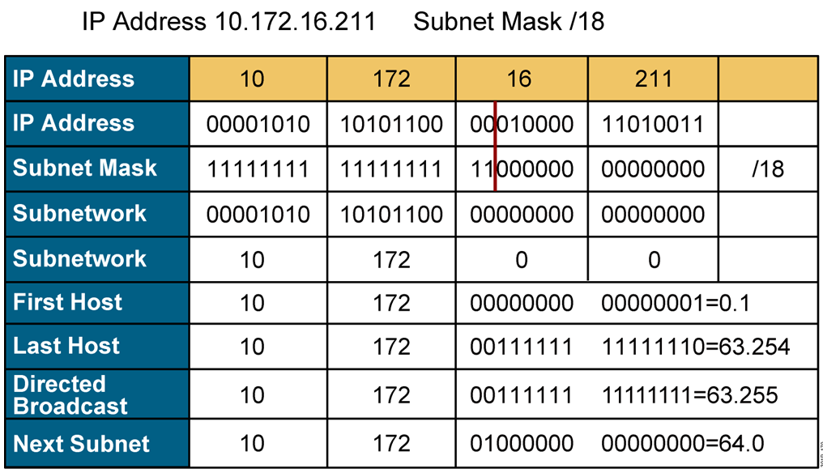
Example: Applying a Subnet Mask for a Class A Address

Slide 57
Exercises: IP Subnetting
Subnetting
Pls determine these features:
☞ Default SM and Current SM
☞ Number of network bit
☞ Number of host bit
☞ Number of Subnet bit
☞ Number of usable subnet
☞ Number of usable host per subnet

Slide 58
Exercises: IP Subnetting
Apply to the following IP address:
a.192.160.1.0/24
Borrow 3 bits
b.171.16.0.0/16
Borrow 8 bits
d.198.10.10.0/29
c.10.16.1.0/8
Borrow 20 bits
f.192.169.12.0/24
Borrow 3 bits
e.179.18.0.0/16
Borrow 12 bits
h.191.172.0.0/20
i.126.172.0.0/30
g.66.65.0.0/28

Slide 59
Exercises Question 1
The IP address 131.107.0.0 is a class B address.
What is the range of binary values for the first octet in this address class?
10000000 - 11111111
B. 00000000 - 10111111
C. 10000000 - 10111111
D. 10000000 - 11011111
E. 11000000 - 11101111

Slide 60
Exercises Question 2
What is the network address for a host with
the IP address 123.200.8.68/28?
123.200.8.0
B. 123.200.8.32
C. 123.200.8.64
D. 123.200.8.65
E. 123.200.8.31
F. 123.200.8.1

Slide 61
Exercises Question 3
Using a class C address range 192.168.21.12
your network needs twenty-eight subnets.
Which subnet mask should you use?
255.255.0.28
255.255.255.0
255.255.255.28
255.255.255.248
255.255.255.252

Slide 62

Exercises Question 4
You need to configure an IP address for workstation TestKingA. Based on the information shown above, what IP address should be assigned to this host?
A. 192.168.1.159/28
B. 192.168.1.145/28
C. 192.168.1.160/28
D. 192.168.1.144/28
E. 192.168.1.143/28
Answer: B

Slide 63
Exercises Question 5
Which of the following addresses can be assigned to a host when using a subnet mask of 255.255.254.0? (Select three)
A. 113.10.4.0
B. 186.54.3.0
C. 175.33.3.255
D. 26.35.2.255
E. 152.135.7.0
F. 17.35.36.0
Answer: B, D, E
Notes:
B: Valid Host in subnetwork 2 ( 92.11.178.64 to 92.11.178.95) C: Valid Host in subnetwork 1(134.178.18.32 to 134.178.18.63) D: Valid host in subnetwork 2 (192.168.16.64 to 192.168.16.95

Slide 64
Exercises Question 5
You are configuring a subnet on the TestKing branch office in Berlin. You need to assign IP addresses to hosts in this subnet. You have been given the subnet mask of 255.255.255.224. Which IP address would be valid? (Choose three) A. 15.234.118.63 B. 92.11.178.93 C. 134.178.18.56 D. 192.168.16.87 E. 201.45.116.159 F. 217.63.12.192
Notes:
B: Valid Host in subnetwork 2 ( 92.11.178.64 to 92.11.178.95) C: Valid Host in subnetwork 1(134.178.18.32 to 134.178.18.63) D: Valid host in subnetwork 2 (192.168.16.64 to 192.168.16.95

Slide 65
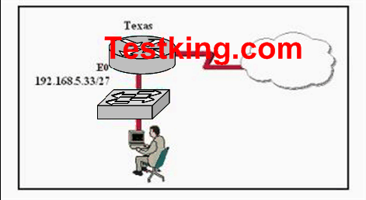
Exercises Question 6
Answer: C
Based on the information above, which IP address should be assigned to the host?
A. 192.168.5.5 B. 192.168.5.32
C. 192.168.5.40 D. 192.168.5.63
E. 192.168.5.75 F. None of the above

Slide 66
Exercises Question 7
If a host on a network has the address 172.16.45.14/30, what is the address of the subnetwork to which this host belongs?
A. 172.16.45.0
B. 172.16.45.4
C. 172.16.45.8
D. 172.16.45.12
E. 172.16.45.18
Answer: D

Slide 67
Exercises Question 8
Give the following IP: 172.16.80.92/20, 172.16.32.100/20 and 172.16.65.100/20.
What are the broadcast addresses of the subnets in which these IP address belong to?
(Select three options.)
A. 172.16.82.255
B. 172.16.95.255
C. 172.16.64.255
D. 172.16.32.255
E. 172.16.47.255
F. 172.16.79.255
Correct Answer : B , E , F

Slide 68
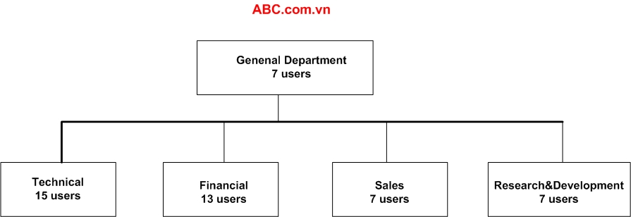
Exercises Question 9
ABC company is acquiring a new Class C IP network.
Which of the following subnet masks will provide one useful subnet for each department while still making allowance for enough usable host addresses per department as specified in the graphic?
A. 255.255.255.128
B. 255.255.255.192
C. 255.255.255.224
D. 255.255.255.240
E. 255.255.255.248
F. 255.255.255.252
Correct Answer : C

Slide 69
Exercises Question 10
You are a network technician at NewStar.vn. Your company has a larger 172.12.0.0 network that you want to divide into subnets. You want each subnet to support 459 hosts. You also want to provide the maximum number of subnets.
Which network mask should you use?
A. 255.255.0.0
B. 255.255.128.0
C. 255.255.224.0
D. 255.255.254.0
Correct Answer : D

Slide 70
Exercises Question 11
You are a network administrator at Seibels. You must configure a new subnetwork at the Seibels branch office in Berlin. You have been provided with the subnet mask of 255.255.255.224. You want to assign IP addresses to hosts on the subnet.
Which of the following IP addresses would you use? (Choose all that apply.)
A. 16.23.118.63
B. 87.45.16.159
C. 92.11.178.93
D. 134.178.18.56
E. 192.168.16.87
F. 217.168.166.192
Correct Answer : C, D, E
Notes:
Explanation: C: Valid Host in subnetwork 2 ( 92.11.178.64 to 92.11.178.95) D: Valid Host in subnetwork 1(134.178.18.32 to 134.178.18.63) E: Valid host in subnetwork 2 (192.168.16.64 to 192.168.16.95

Slide 71
Exercises Question 12
You are a network technician at Zysese company. You have subnetted the 210.106.14.0 network with a /24 mask.
Your supervisor asks you how many usable subnetworks and usable host addresses per subnet this would
make provision for.
What would your response be?
A. 1 network with 254 hosts
B. 4 networks with 128 hosts
C. 2 networks with 24 hosts
D. 6 networks with 64 hosts
E. 8 networks with 36 hosts
Correct Answer : A

Slide 72
Exercises Question 13
You have subnetted the 213.105.72.0 network with a /28 mask. How many usable subnetworks and usable host addresses per subnet will be provided?
A. 2 networks with 62 hosts
B. 6 networks with 30 hosts
C. 16 networks and 16 hosts
D. 62 networks and 2 hosts
E. 16 networks and 14 hosts
Correct Answer : E

Slide 73
Exercises Question 14
You are a network technician at Fravo, Inc. You are planning a network installation for the company. The design requires 100 separate subnetworks, resulting in the acquisition of a Class B network address. Which of the following subnet masks will provide the 100 subnetworks required, if 500 usable host addresses are required per subnet?
A. 255.255.0.0
B. 255.255.224.0
C. 255.255.254.0
D. 255.255.255.0
E. 255.255.255.224
F. 255.255.255.254
Correct Answer : C

Slide 74
Exercises Question 15
You are a network technician at company. Company has a class C network license. The company requires 5 usable subnets. Each subnet must accommodate at least 18 hosts.
Which network mask should you use?
A. 225.225.224.0
B. 225.225.240.0
C. 225.225.255.0
D. 255.255.255.224
E. 225.225.255.240
Correct Answer : D

Slide 75
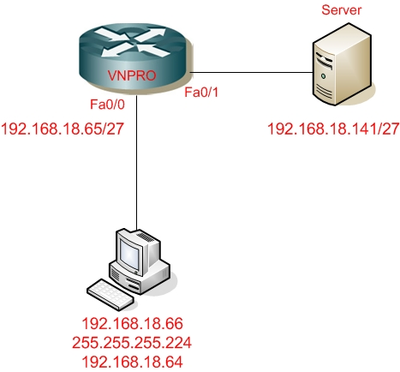
Question 16
You are a network technician at NEWSTAR company. You add a new workstation to the network to
accommodate a new employee. The relevant section of the network is shown in the beside exhibit.
The employee is unable to connect to the server at IP address 192.168.18.141/27.
Can you identify the incorrectly configured network parameter in the workstation configuration?
A. IP address of the Ethernet 0 router interface
B. Server
C. Workstation default gateway
D. Workstation subnet mask
E. Workstation IP address
SPKT
Correct Answer : C

Slide 76
Exercise: In the following questions, assume you can use zero and broadcast subnets
9. What are the Broadcast addresses in each of these /24 subnets?
145.126.203.0/24
145.126.204.0/24
145.126.205.0/24
10. What are the Broadcast addresses in each of these /16 subnets?
188.74.0.0/16
188.75.0.0/16
188.76.0.0/16

Slide 77
Exercise: In the following questions, assume you can use zero and broadcast subnets
11. You've applied a new /27 subnet mask to the following /24 network block.
11001110.00010011.0001000.xxxxxxxx = 206.19.16.0/24
11111111.11111111.1111111.11100000 = new /27 subnet mask
-------------------------------------------------
11001110.00010011.0001000.xxx00000
What are the network addresses of the first 4 new subnets?
What is the network increment? Assume you can use zero and broadcast subnets.

Slide 78
Exercise: In the following questions, assume you can use zero and broadcast subnets
12. You've applied a new /19 subnet mask to the following /15 network block.
01111100.110111xx.xxxxxxxx.xxxxxxxx = 124.220.0.0/15
11111111.11111111.11100000.00000000 = new /19 subnet mask
---------------------------------------------------
01111100.110111xx.xxx00000.00000000
What are the network addresses of the first 5 new subnets?
What is the network increment? Assume you can use zero and broadcast subnets.

Slide 79
Exercise
" Công ty ABC có 14 chi nhánh ở 14 tỉnh, tương lai có thể mở thêm 30 chi nhánh. công ty hiện đang sử dụng lớp IP:172.16.0.0,hãy tiến hành chia mạng con theo từng chi nhánh.Tìm SubnetMask,phạm vi IP cấp phát cho mỗi chi nhánh."

Slide 80
Exercise
Trả lời: Thứ nhất, xác định số bit cần mượn để làm subnet. Số subnet cần = 14 + 30 = 44 (subnet) --> phải mượn 6 bit để làm subnet.
Số subnet có được = 2^6-2 = 62 (subnet)
Subnet Mask = 255.255.252.0 (252 = 2^7 + 2^6 + 2^5+2^4+2^3+2^2)
Tiếp theo, xác định số host trên mỗi subnet: Địa chỉ trên thuộc lớp B --> phần hostID là 16 bit, cho mượn 6 bit làm subnet --> còn 10 bit. Vậy số host/1 subnet = 2^10 - 2 = 1022 (host)
Xác định bước nhảy (khoảng cách giữa các subnet) = 256 - 252 = 4 Vậy các subnet lần lượt là: 172.16.4.0 (host: 172.16.4.1 - 172.16.7.254) 172.16.8.0 172.16.12.0 ............. 172.16.252.0

Slide 81
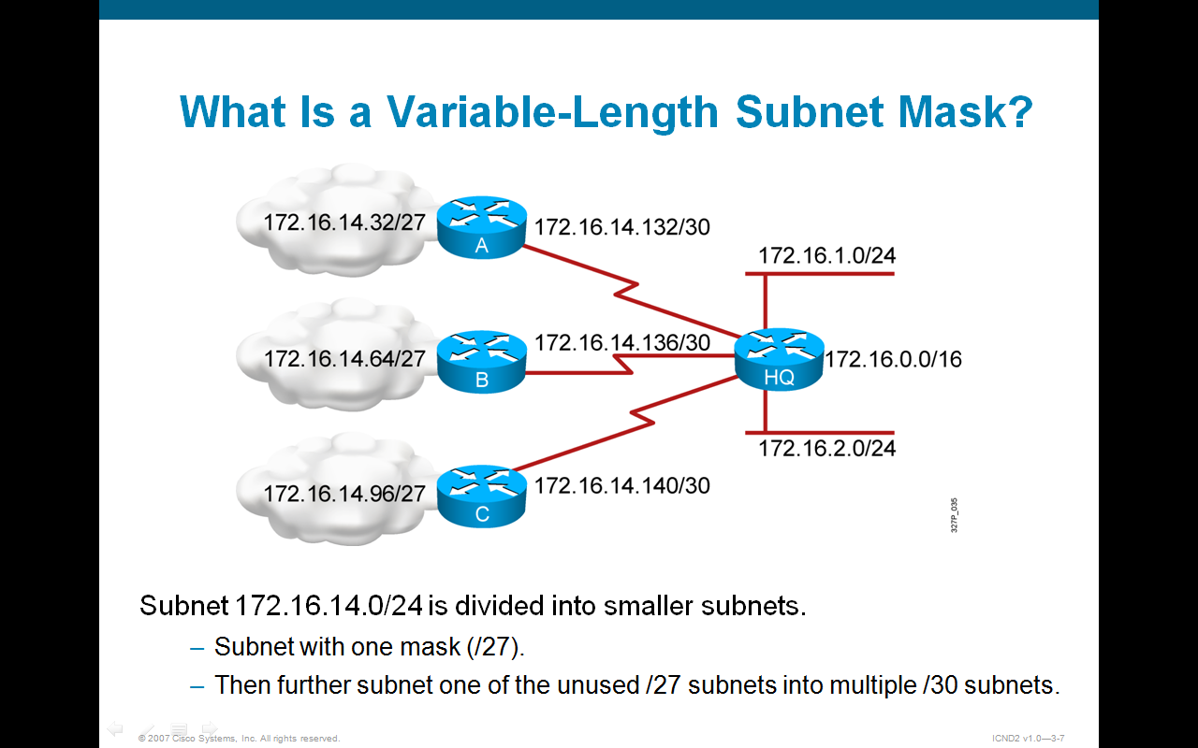
Variable-length Subnet Mask

Slide 82
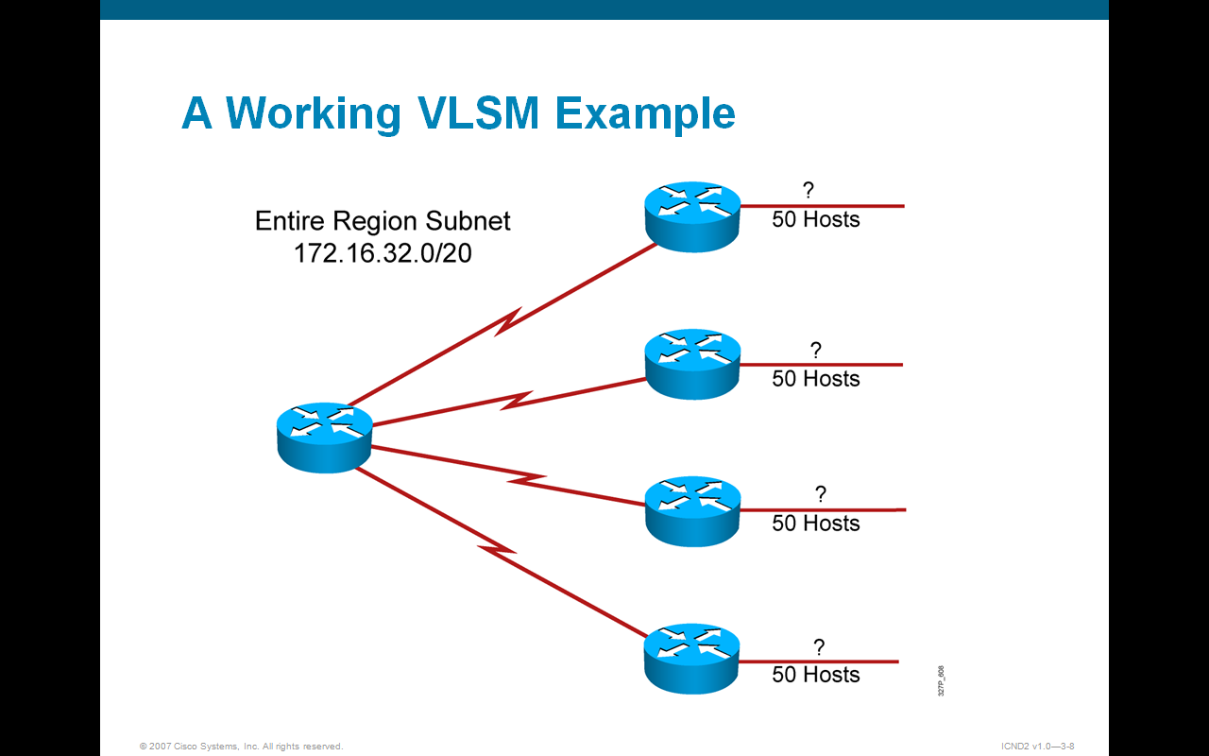
Variable-length Subnet Mask

Slide 83
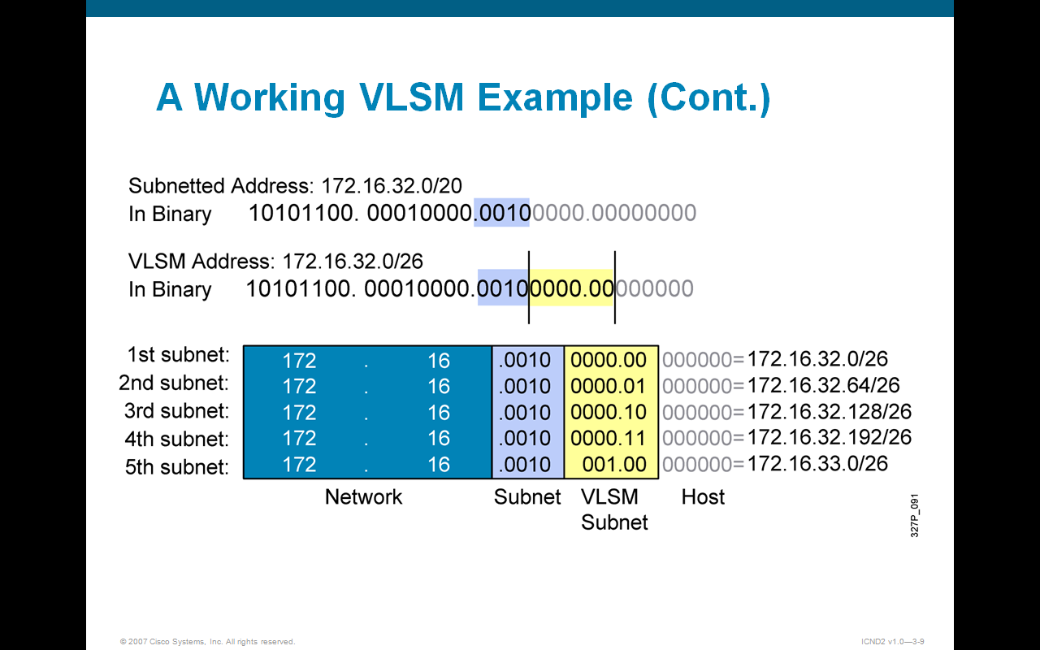
Variable-length Subnet Mask

Slide 84
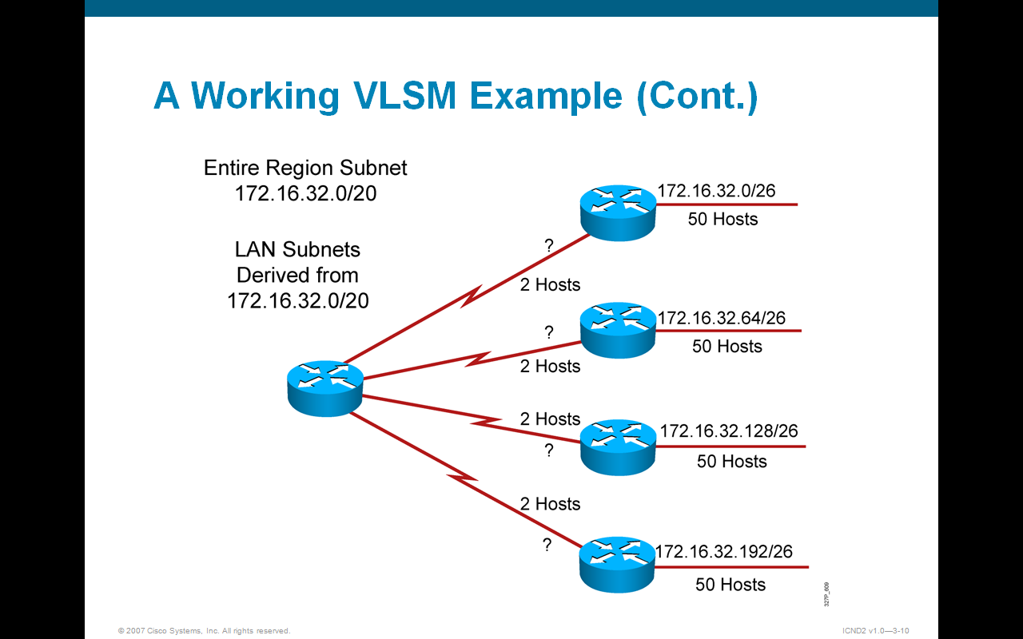
Variable-length Subnet Mask

Slide 85
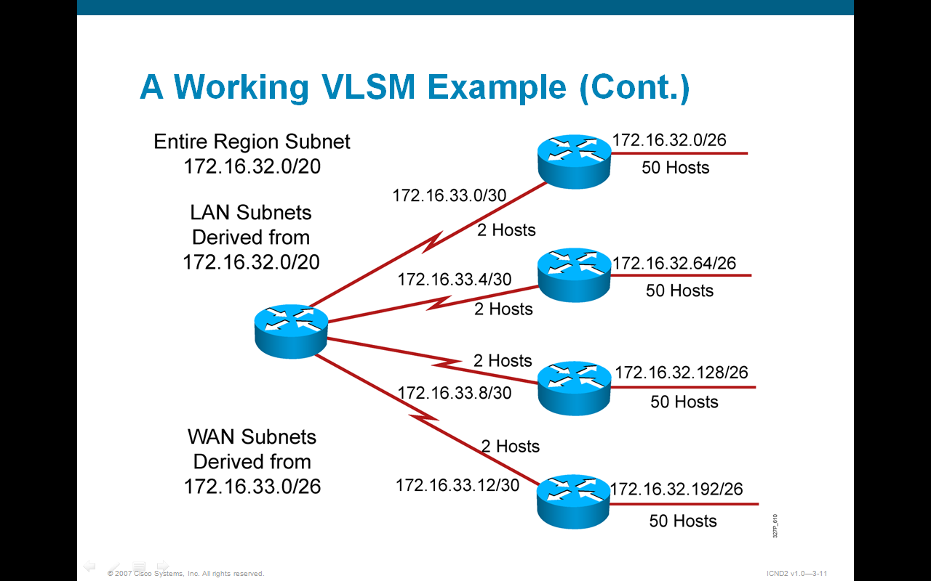
Variable-length Subnet Mask

Slide 86
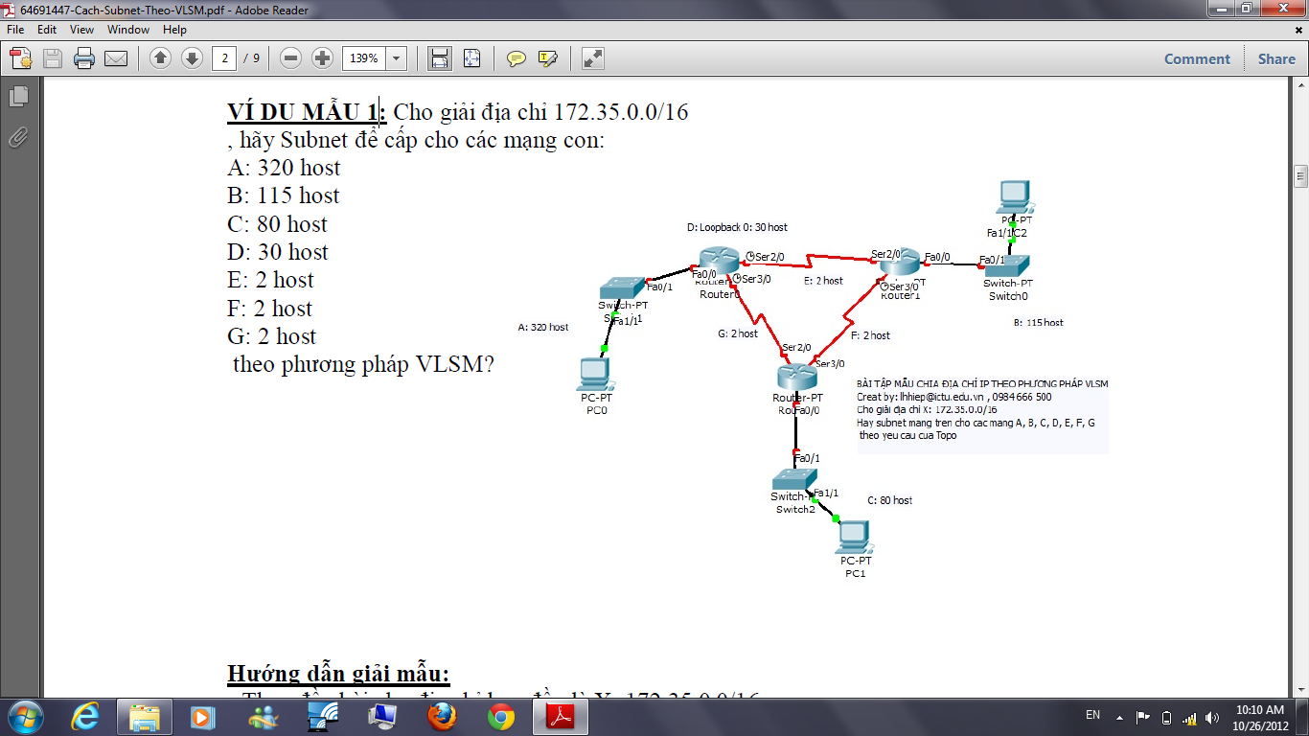
Bài tập tại lớp
Notes:
Hướng dẫn giải mẫu:
- Theo đầu bài cho địa chỉ ban đầu là X: 172.35.0.0/16
=> đổi ra hệ nhị phân ta được:
10101100.00100011.00000000.00000000
11111111.11111111.00000000.00000000
- B1: Theo VLSM thì ta sẽ phải chia X cho các mạng theo chiều giảm dần, tức là chia cho mạng có số host cao nhất rồi thấp nhất cuối cùng-> sắp xếp lại ta có:
- B2: +Thực hiện chia X cho mạng A đầu tiên, áp dụng công thức: 2n - 2 ≥ 320 => n=9 (chính là số bit còn lại chưa bị mượn) => số bit đã mượn là m= 32 (là tổng số bit của 1
địa chỉ IP v4) – 16 (số bit thuộc phần Net_id của địa chỉ đã cho) – 9 ( số bit còn lại) = 7
=> SM’ (Subnet Mask mới) = SM (Subnet Mask cũ) + m = 16 + 7 = 23 ( viết tắt là /23)
& số Subnet (mạng con) được tạo ra là: 2m = 27 = 128
với SM’ thay đổi từ /16 thành /23 (các bit trong khoảng này của X đã chuyển sang Octet
thứ 3) nên ta có
101100.00100011.00000000.00000000
172. 16. 0. 0
(bit màu đen không in đậm & bị gạch chân chính là 7 bit vừa mượn, việc sinh ra các Subnet con chính là dựa vào việc thay đổi vị trí và giá trị từ 0 thành 1 của những bit này) Vậy các mạng con được sinh ra từ X là:
| Octet 3 |
Mạng X1: 10101100.00100011.00000000.00000000 -> 172.35.0.0/23
Mạng X2: 10101100.00100011.00000010.00000000 -> 172.35.2.0/23
Mạng X3: 10101100.00100011.00000100.00000000 -> 172.35.4.0/23
………………… vân vân ………………….
Mạng X127: 10101100.00100011.1111110.00000000 -> 172.35.252.0/23
Mạng X128: 10101100.00100011.11111110.00000000 -> 172.35.254.0/23
(chú ý, để ý ta thấy chỉ cần tính đến mạng thứ 3 trở đi là ta đã có thể tìm được bước nhảy
giữa 2 mạng liền kề là 2: lấy octet tương ứng của mạng sau trừ octet mạng trước)
=> lấy mạng con đầu tiên X1: 172.35.0.0/23 cấp cho mạng A: 320 host
+ Tiếp theo, lấy mạng X2 (là địa chỉ mạng lớn nhất tiếp theo) chia cho mạng B:115 host. Tương tự trên, theo công thức: 2n - 2 ≥ 115 => n=7 => m = 32-23-7 = 2
=> SM’ (Subnet Mask mới) = SM (Subnet Mask cũ) + m = 23 +2 = 25 ( viết tắt là /25)
& số Subnet (mạng con) được tạo ra là: 2m = 22 = 4
với SM thay đổi từ /23 thành /25 (các bit trong khoảng này của X2 liên quan đến cả Octet
3 và Octet thứ 4) nên ta có các mạng con mới sinh ra từ X2:
| Octet 3 | | Octet 4 |
Mạng X21:10101100.00100011.00000010.0000000-> 172.35.2.0/25
Mạng X22:10101100.00100011.00000010.1000000-> 172.35.2.128/25
Mạng X23:10101100.00100011.00000011.0000000-> 172.35.3.0/25
Mạng X24:10101100.00100011.00000011.1000000-> 172.35.3.128/25
=> lấy mạng X21: 172.35.2.0/25 cấp cho mạng B: 115 host
+ Tiếp theo, ta sử dụng mạng con X22: 172.35.2.128/25 để chia cho mạng C: 80 host Tương tự trên, theo công thức: 2n - 2 ≥ 80 => n=7 => m = 32-25-7 = 0 (Vừa đẹp, khi giá trị m=0 điều này chứng tỏ là mạng đang chia chỉ có thể cấp vừa đủ hoặc thừa một số IP cho mạng có số host đang yêu cầu, ở đây là 115 host- chú ý: khi sử dụng VLSM thì m sẽ không bao giờ nhận giá trị âm)
=> cấp luôn X22 cho mạng C: 80 host
+ Lúc này cần phải dùng đến giải địa chỉ X23 để chia cho mạng D: 30 host
Tương tự trên, theo công thức: 2n - 2 ≥ 30 => n=5 => m = 32-25-5 = 2
=> SM’ (Subnet Mask mới) = SM (Subnet Mask cũ) + m = 25 +2 = 27 ( viết tắt là /27)
& số Subnet (mạng con) được tạo ra là: 2m = 22 = 4
với SM thay đổi từ /25 thành /27 (các bit trong khoảng này của X23 liên quan đến Octet
thứ 4) nên ta có các mạng con mới sinh ra từ X23:
| Octet 4 |
Mạng X231:10101100.00100011.00000011.00000000-> 172.35.3.0/27
Mạng X232:10101100.00100011.00000011.00100000-> 172.35.3.32/27
Mạng X233:10101100.00100011.00000011.01000000-> 172.35.3.64/27
Mạng X234:10101100.00100011.00000011.01100000-> 172.35.3.96/27
=> lấy X231: 172.35.3.0/27 cấp cho mạng D: 30 host
+ Lấy X232 chia cho các mạng E: 2 host, F: 2 host, G: 2 host
Tương tự trên, theo công thức: 2n - 2 ≥ 2 => n=2 => m = 32-27-2 = 3
=> SM’ (Subnet Mask mới) = SM (Subnet Mask cũ) + m = 27 +3 = 30 ( viết tắt là /30)
& số Subnet (mạng con) được tạo ra là: 2m = 23 = 8
với SM thay đổi từ /27 thành /30 (các bit trong khoảng này của X232 liên quan đến Octet
thứ 4) nên ta có các mạng con mới sinh ra từ X232 là:
| Octet 4 |
Mạng X2321:10101100.00100011.00000011.00100000-> 172.35.3.32/30
Mạng X2322:10101100.00100011.00000011.00100100-> 172.35.3.36/30
Mạng X2323:10101100.00100011.00000011.00101000-> 172.35.3.40/30
………………… vân vân ………………….
Mạng X2327:10101100.00100011.00000011.00111000-> 172.35.3.56/30
Mạng X2328:10101100.00100011.00000011.00111100-> 172.35.3.60/30
=> lấy mạng Mạng X2321: 172.35.3.32/30 cấp cho mạng E: 2 host
=> lấy mạng Mạng X2322: 172.35.3.36/30 cấp cho mạng F: 2 host
=> lấy mạng Mạng X2323: 172.35.3.40/30 cấp cho mạng G: 2 host
KẾT LUẬN
Sau khi cấp các địa chỉ mạng con cho các mạng A, B, C, D, E, F, G sẽ còn dư các mạng chưa được sử dụng (để giành khi cần ta có thể sử dụng để cấp phát hoặc chia nhỏ tiếp). Phương pháp VLSM này sẽ giúp ta kiểm soát được phần địa chỉ dư thừa chưa được sử dụng.

Slide 87
Results
Tên mạ ng | Số host yêu cầu | Địa chỉ mạng | Pref ix | Subnet Mask | Giải địa chỉ khả dụng | Địa chỉ Broadcast
A | 320 | 172.35.0.0 | /23 | 255.255.254 .0 | 172.35.0.1 - 172.35.1.254 | 172.35.1.25 5
B | 115 | 172.35.2.0 | /25 | 255.255.255 .128 | 172.35.2.1 - 172.35.2.126 | 172.35.2.12 7
C | 80 | 172.35.2.12 8 | /25 | 255.255.255 .128 | 172.35.2.129 - 172.35.2.254 | 172.35.2.25 5
D | 30 | 172.35.3.0 | /27 | 255.255.255 .224 | 172.35.3.1 - 172.35.3.30 | 172.35.3.31
E F G | 2 2 2 | 172.35.3.32 172.35.3.36 172.35.3.40 | /30 /30 | 255.255.255 .252 | 172.35.3.33 - 172.35.3.34 | 172.35.3.35 172.35.3.39 172.35.3.43

Slide 88
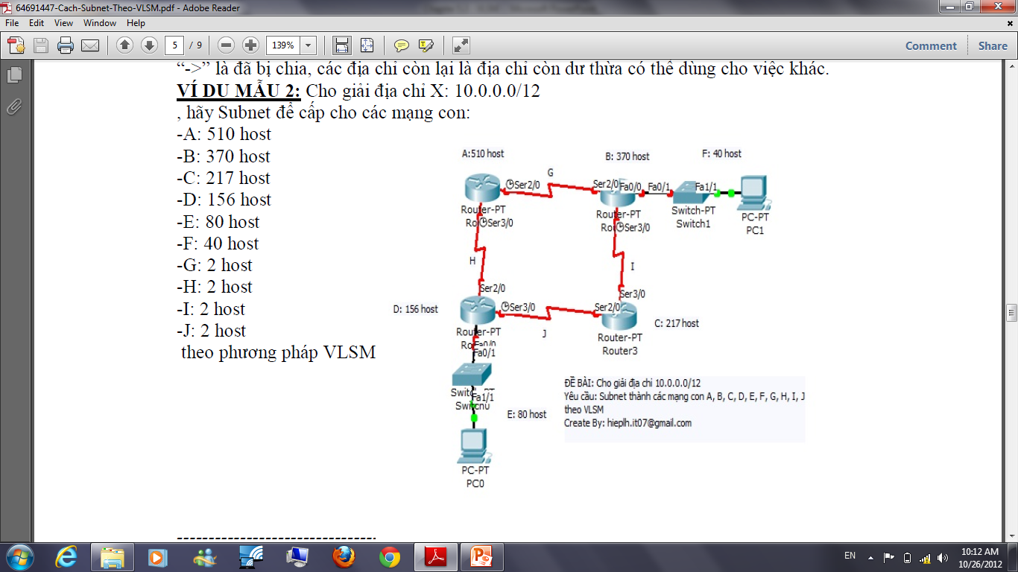
Bài tập tại lớp (nộp để tính điểm)

